Slide 1
Chapter 4 Objectives
Understand how the shape of proteins is defined by their linear sequence
Be able to describe common folding patterns and where they might be found in a protein
Be able to describe primary, secondary, tertiary and quaternary structure of a protein
Be able to describe, with examples, how a protein’s three dimensional shape may indicate it’s function

Slide 2
Common folding patterns
Alpha helix & Beta sheet

Slide 3
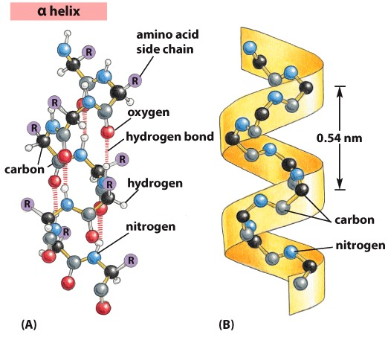
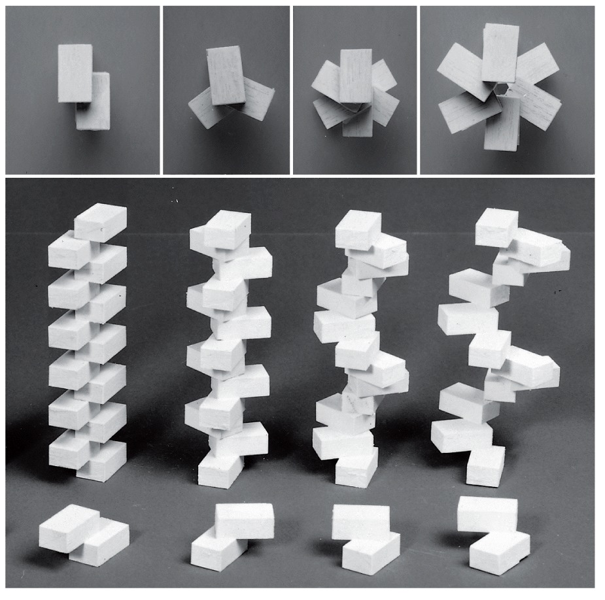
α helix
Common folding pattern
formed by many similar amino acids in a row
Two ‘flavors’: right handed and left handed
Side chains face out
Hydrogen bond linking every 4th carboxyl (CO) of one peptide bond to amino (NH) group of another
Interactions between adjacent amino acids dictates number of turns and width of the spiral

Slide 4
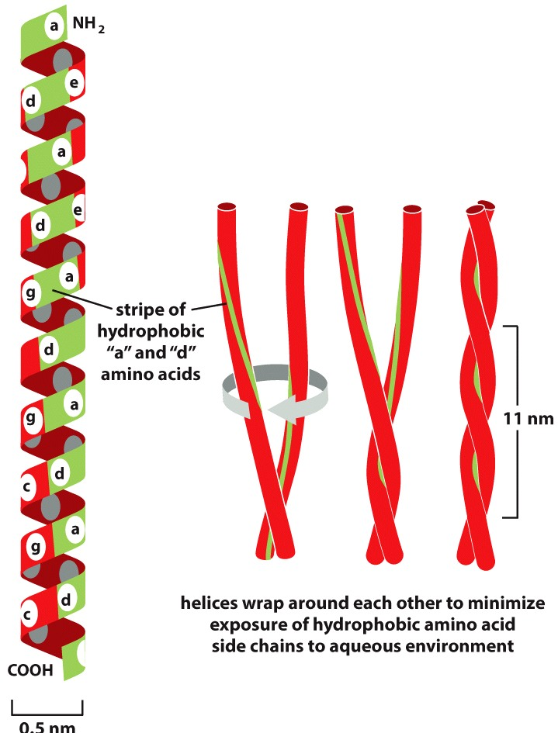
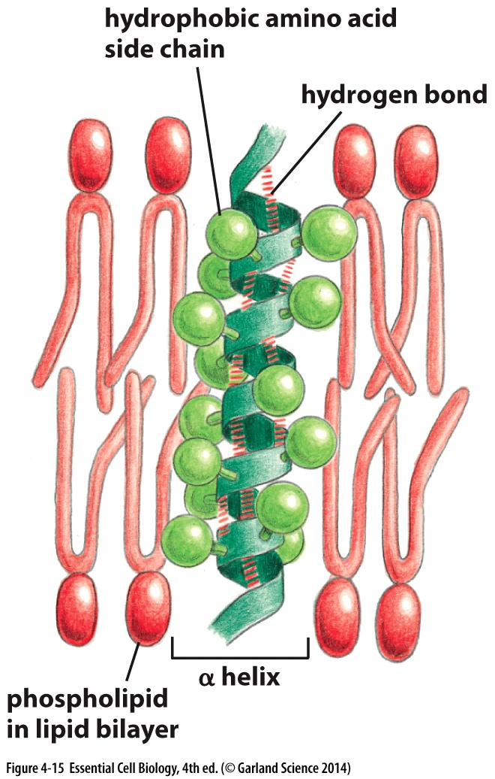
Create hydrophobic or hydrophilic domains
Common in transmembrane proteins:
Hydrophobic side chains interact with fatty acid hydrocarbon tails of phospholipids
Coiled-coil: two helices are intertwined in a rigid structure
sandwich hydrophobic side chains

Slide 5
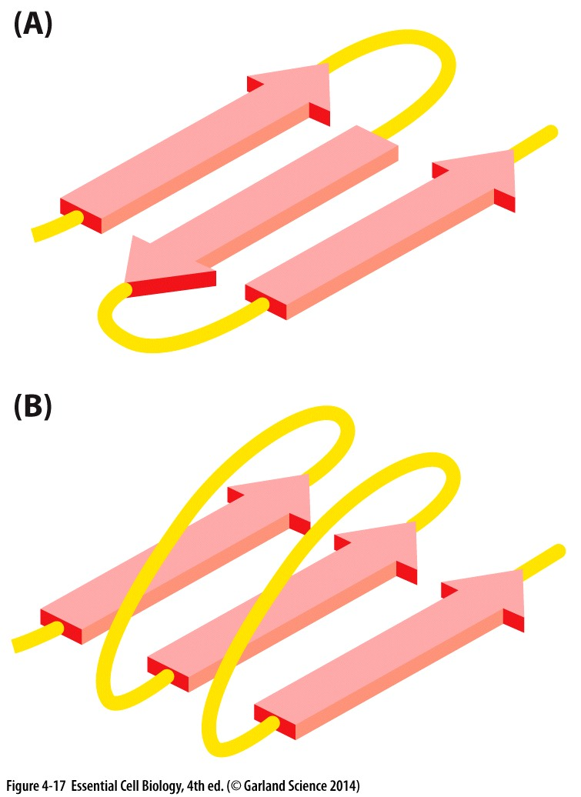
β sheets
Rigid structure at core of proteins
Hydrogen bonds between polypeptide chains that lie side to side
Side chains above/below sheets
Two types:
Parallel
antiparallel
Amount of unstructured linker between parallel chains
C term
N term

Slide 6
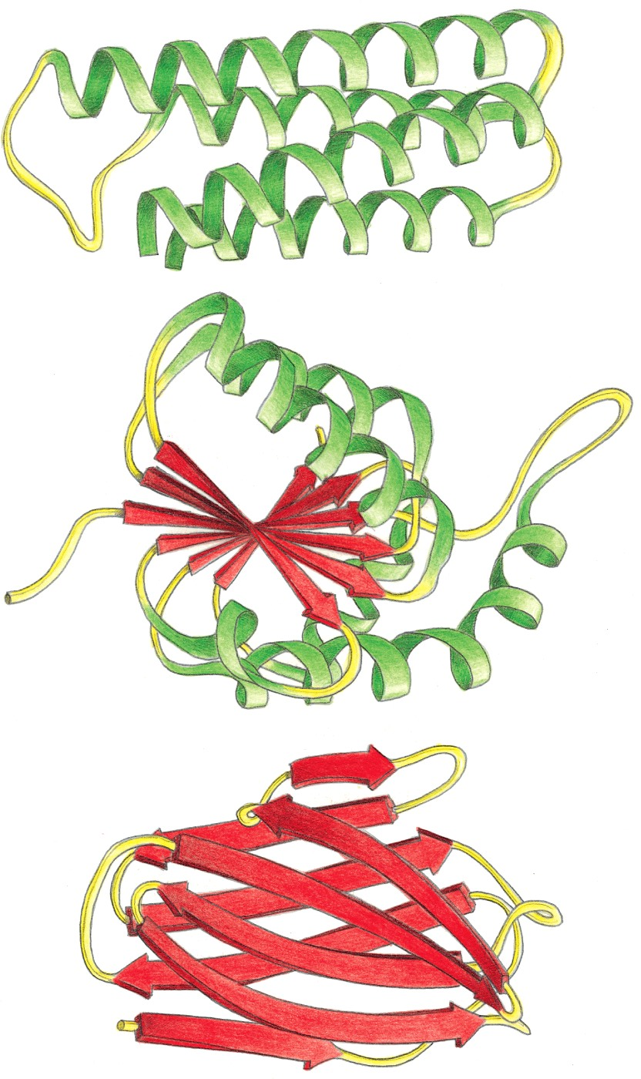
Protein Domains
Protein folding involves multiple levels of organization
α helices and β sheets interact to form domains
Domain: a modular unit that can fold independently into a stable structure
~40-300 amino acids/domain
α helices, β sheets, and the domains they form are examples of secondary (2°) structure

Slide 7
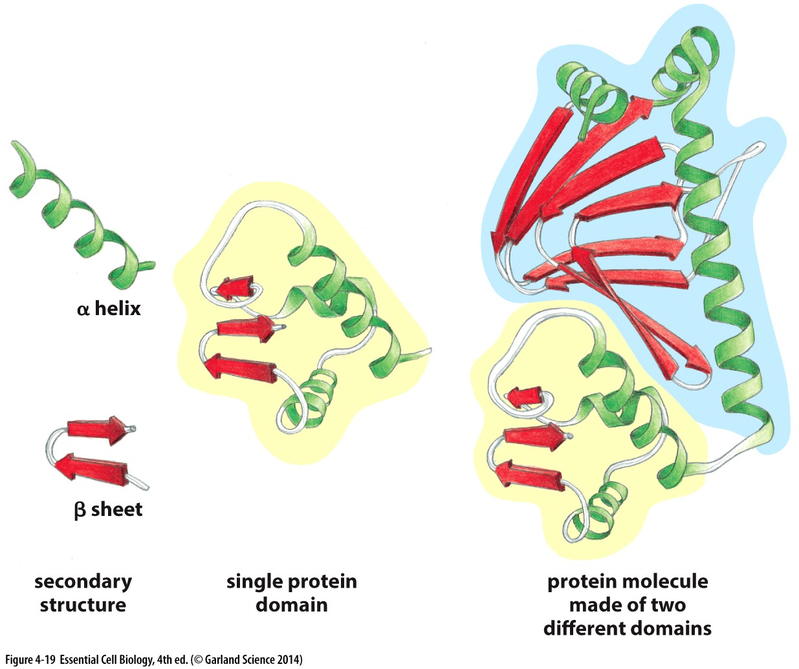
Protein Domains
Domains are modular units pieced together to build proteins
Different domains have different functions
Proteins with similar functions will have similar domains
Interaction of domains form the protein’s tertiary (3°) structure
Notes:
Organization and interaction of 2° structures for domains that interact with other domains to form the proteins tertiary (3°) structure

Slide 8
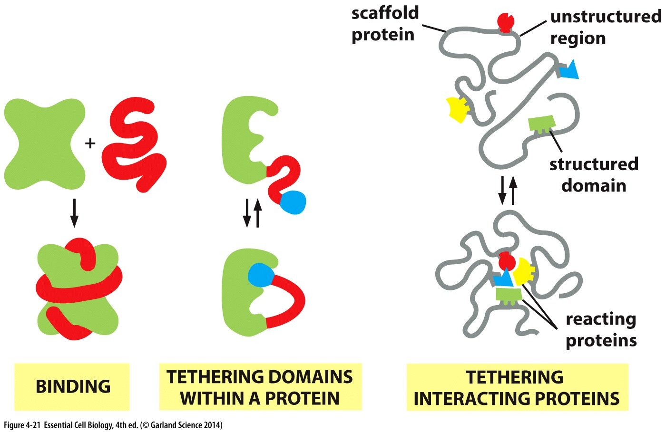
Unstructured regions are important too!
Becomes
structured
keep interacting domains or proteins
in close proximity
Notes:
Unstructured regions can be important to protein function. Sometimes structure is enforced on unstrcutured regions in response to binding of another protein. Other times an unstructured region can serve as a flexible linker between different domains of a single protein, or between different proteins that interact with each other. This type of tethering can be important to increase the local concentration, or likelihood that these different domains or proteins can come together for future interactions. For example, the likelihood of 4 proteins randomly diffusing in a cell, that are needed for a specific cellular function coming together might be small, but if they are all associated with a common linker protein, their geography is limited, their local concentration increased, and they are much more likely to be readily available to interact.

Slide 9
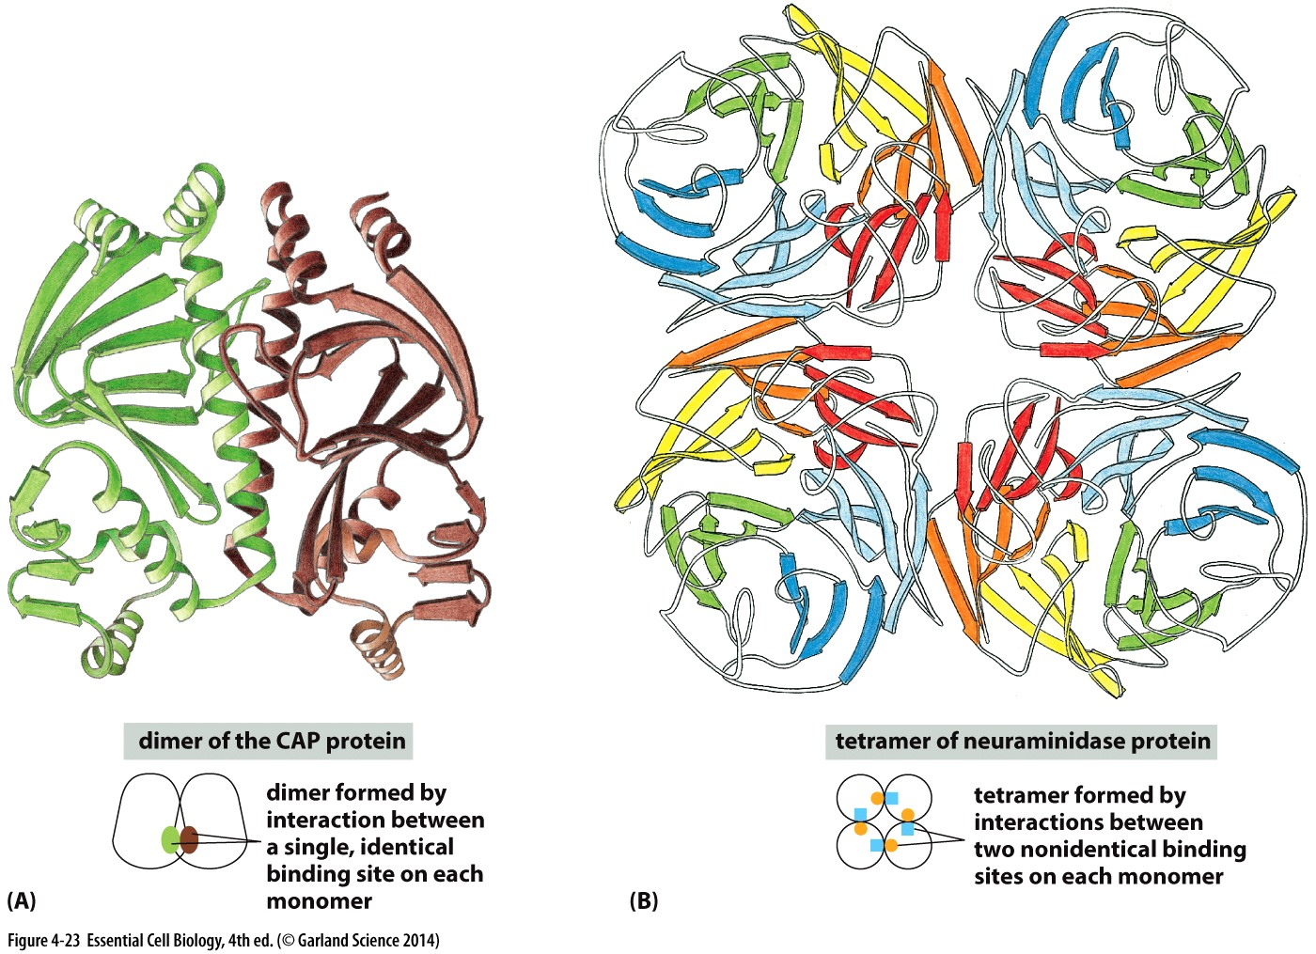
Multimeric proteins
Structure that forms from multiple proteins forming a stable complex is the quaternary structure (4°)
Notes:
Dimers form between two identical polypeptides, also referred to as a homodimer. A heterodimer is formed when two different proteins are bound together, higher order complexes, like tetramers can also form between identical subunits, or between different subunits, or a combination

Slide 10
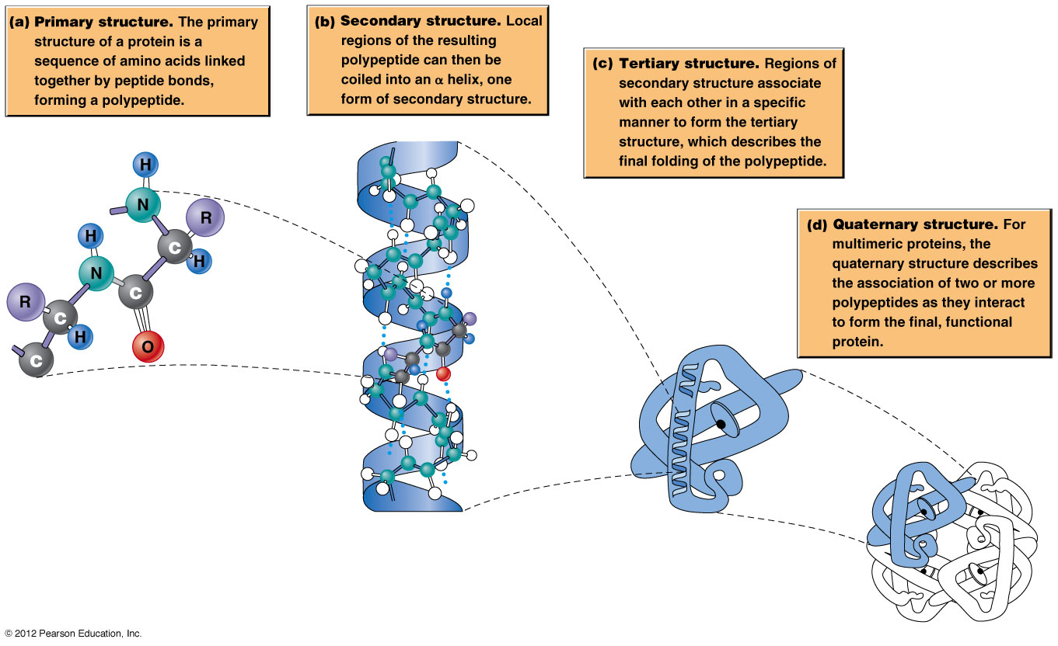
Levels of protein organization
Proteins with similar sequence and/or structure often share similar functions and are grouped into families

Slide 11
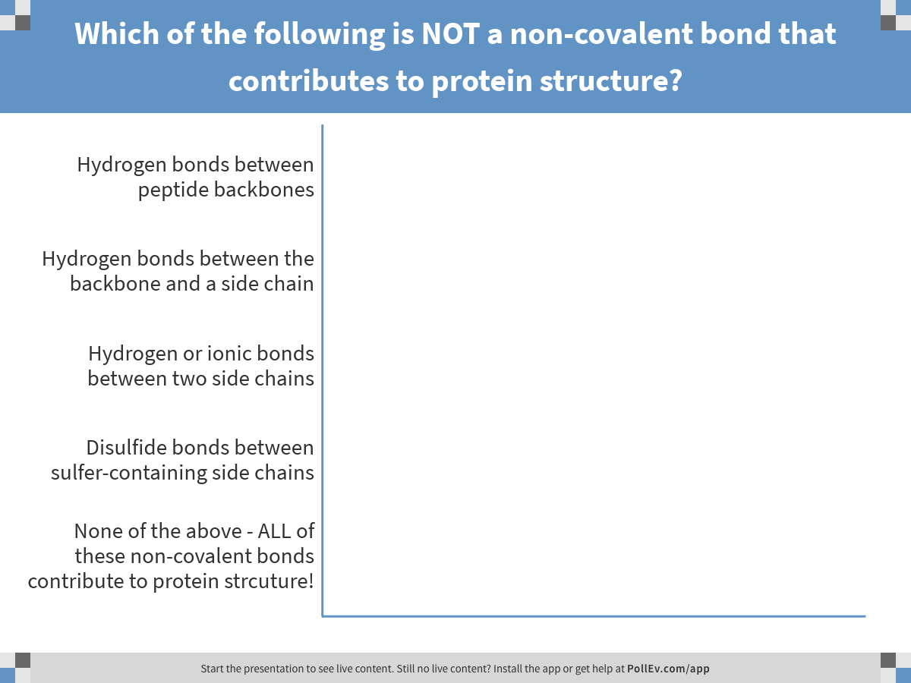
A protein’s folded structure is reinforced by non-covalent interactions.
Notes:
Which of the following is NOT a non-covalent bond that contributes to protein structure?
https://www.polleverywhere.com/multiple_choice_polls/MmAaLsrrlZrpFp2

Slide 12
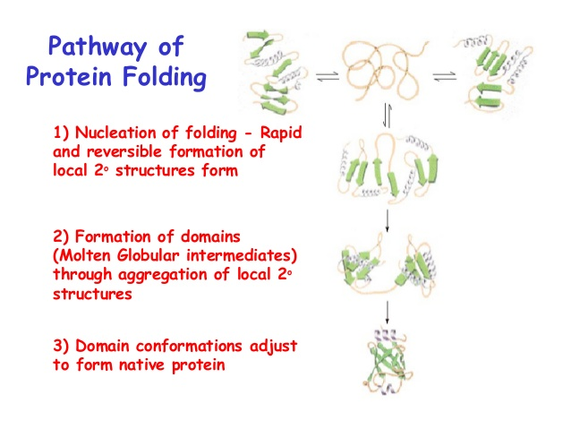

Slide 13
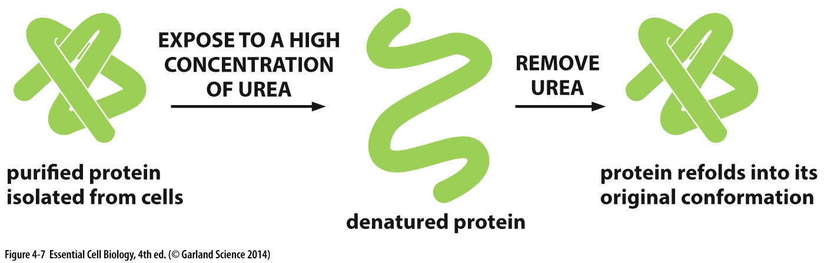
Protein folding gets help
Proteins fold into a conformation of lowest energy
If denatured and given a chance to refold, they will fold into this original low energy conformation
BUT cells have ways to make this happen faster/better
Chaperones!

Slide 14
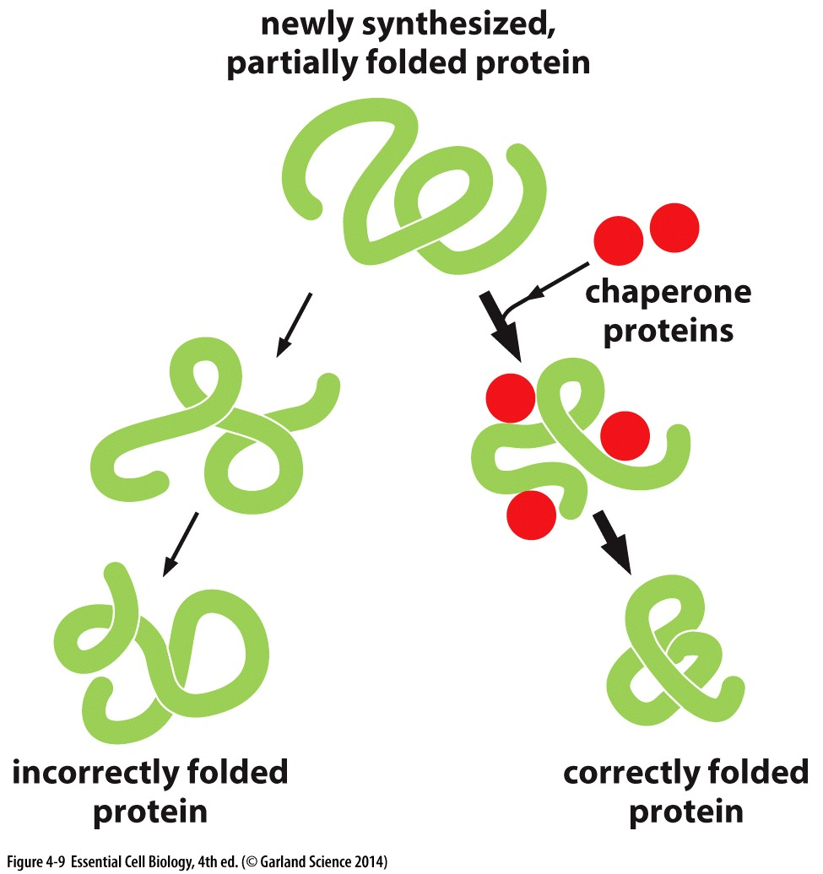
Chaperones guide protein folding
Some protein domains fold as they are being translated (from RNA)
Chaperones can limit folding until appropriate peptide length has been synthesized

Slide 15
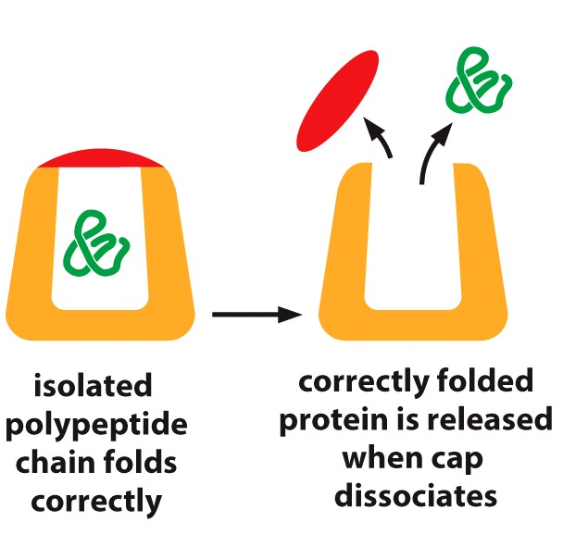
Chaperones guide protein folding
Some protein domains fold as they are being translated (from RNA)
Chaperones can limit folding until appropriate peptide length has been synthesized
Some chaperones provide chambers for proteins to fold in isolation

Slide 16
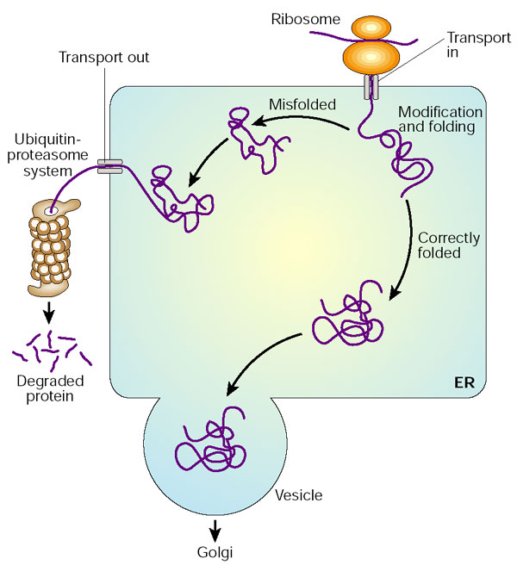
Misfolded proteins
Accidents happen..
Chaperones can guide/correct folding
Misfolded proteins NOT corrected are degraded
Exceptions where degradation of improperly folded proteins aren’t degraded
→ cause disease
+ chaperones
chaperones

Slide 17
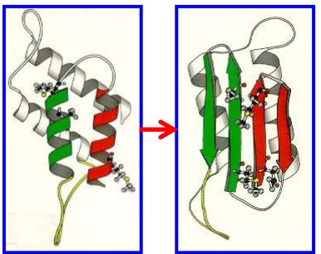
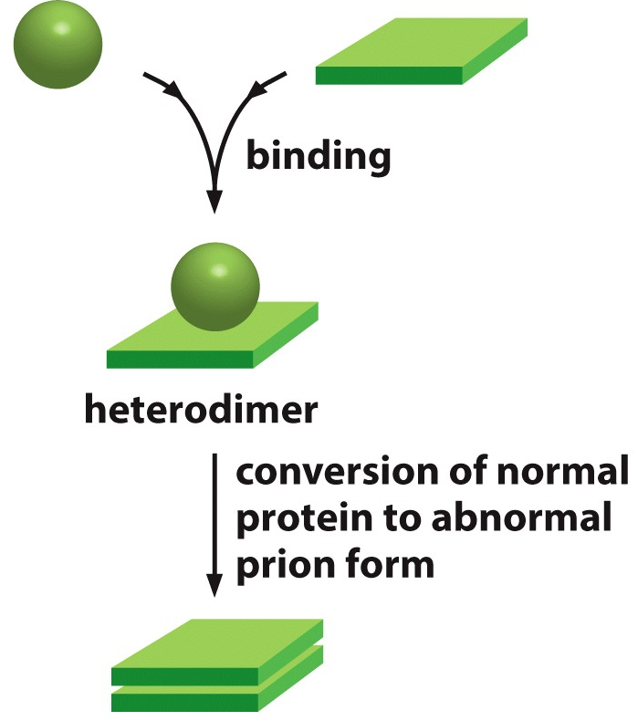
Misfolded proteins can promote more misfolding→ aggregates

Slide 18
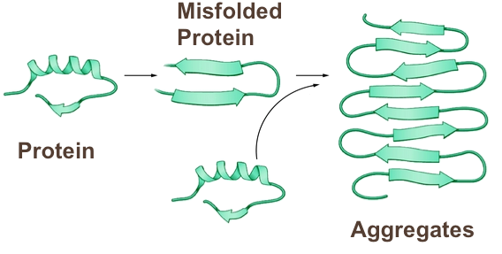
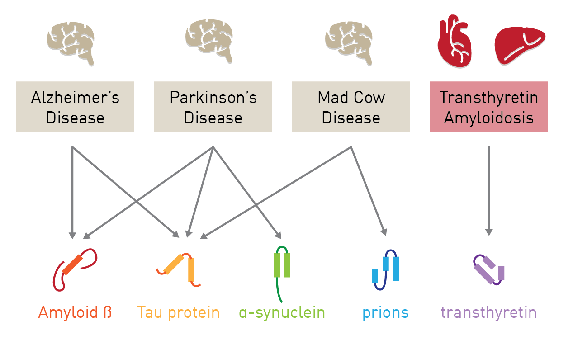
Protein aggregates cause disease
Gain of toxic
activity
Loss of
biological function
Cell death
&
Disease
Misfolded protein diseases:
occur in multiple organs
are defined by specific misfolded protein deposits
Causes not always clear.
Some have contributing genetic factors
Can be passed through infected tissue

Slide 19
How proteins work

Slide 20
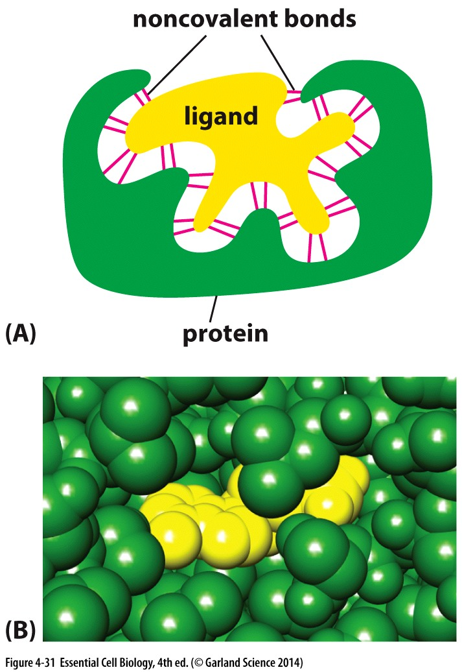
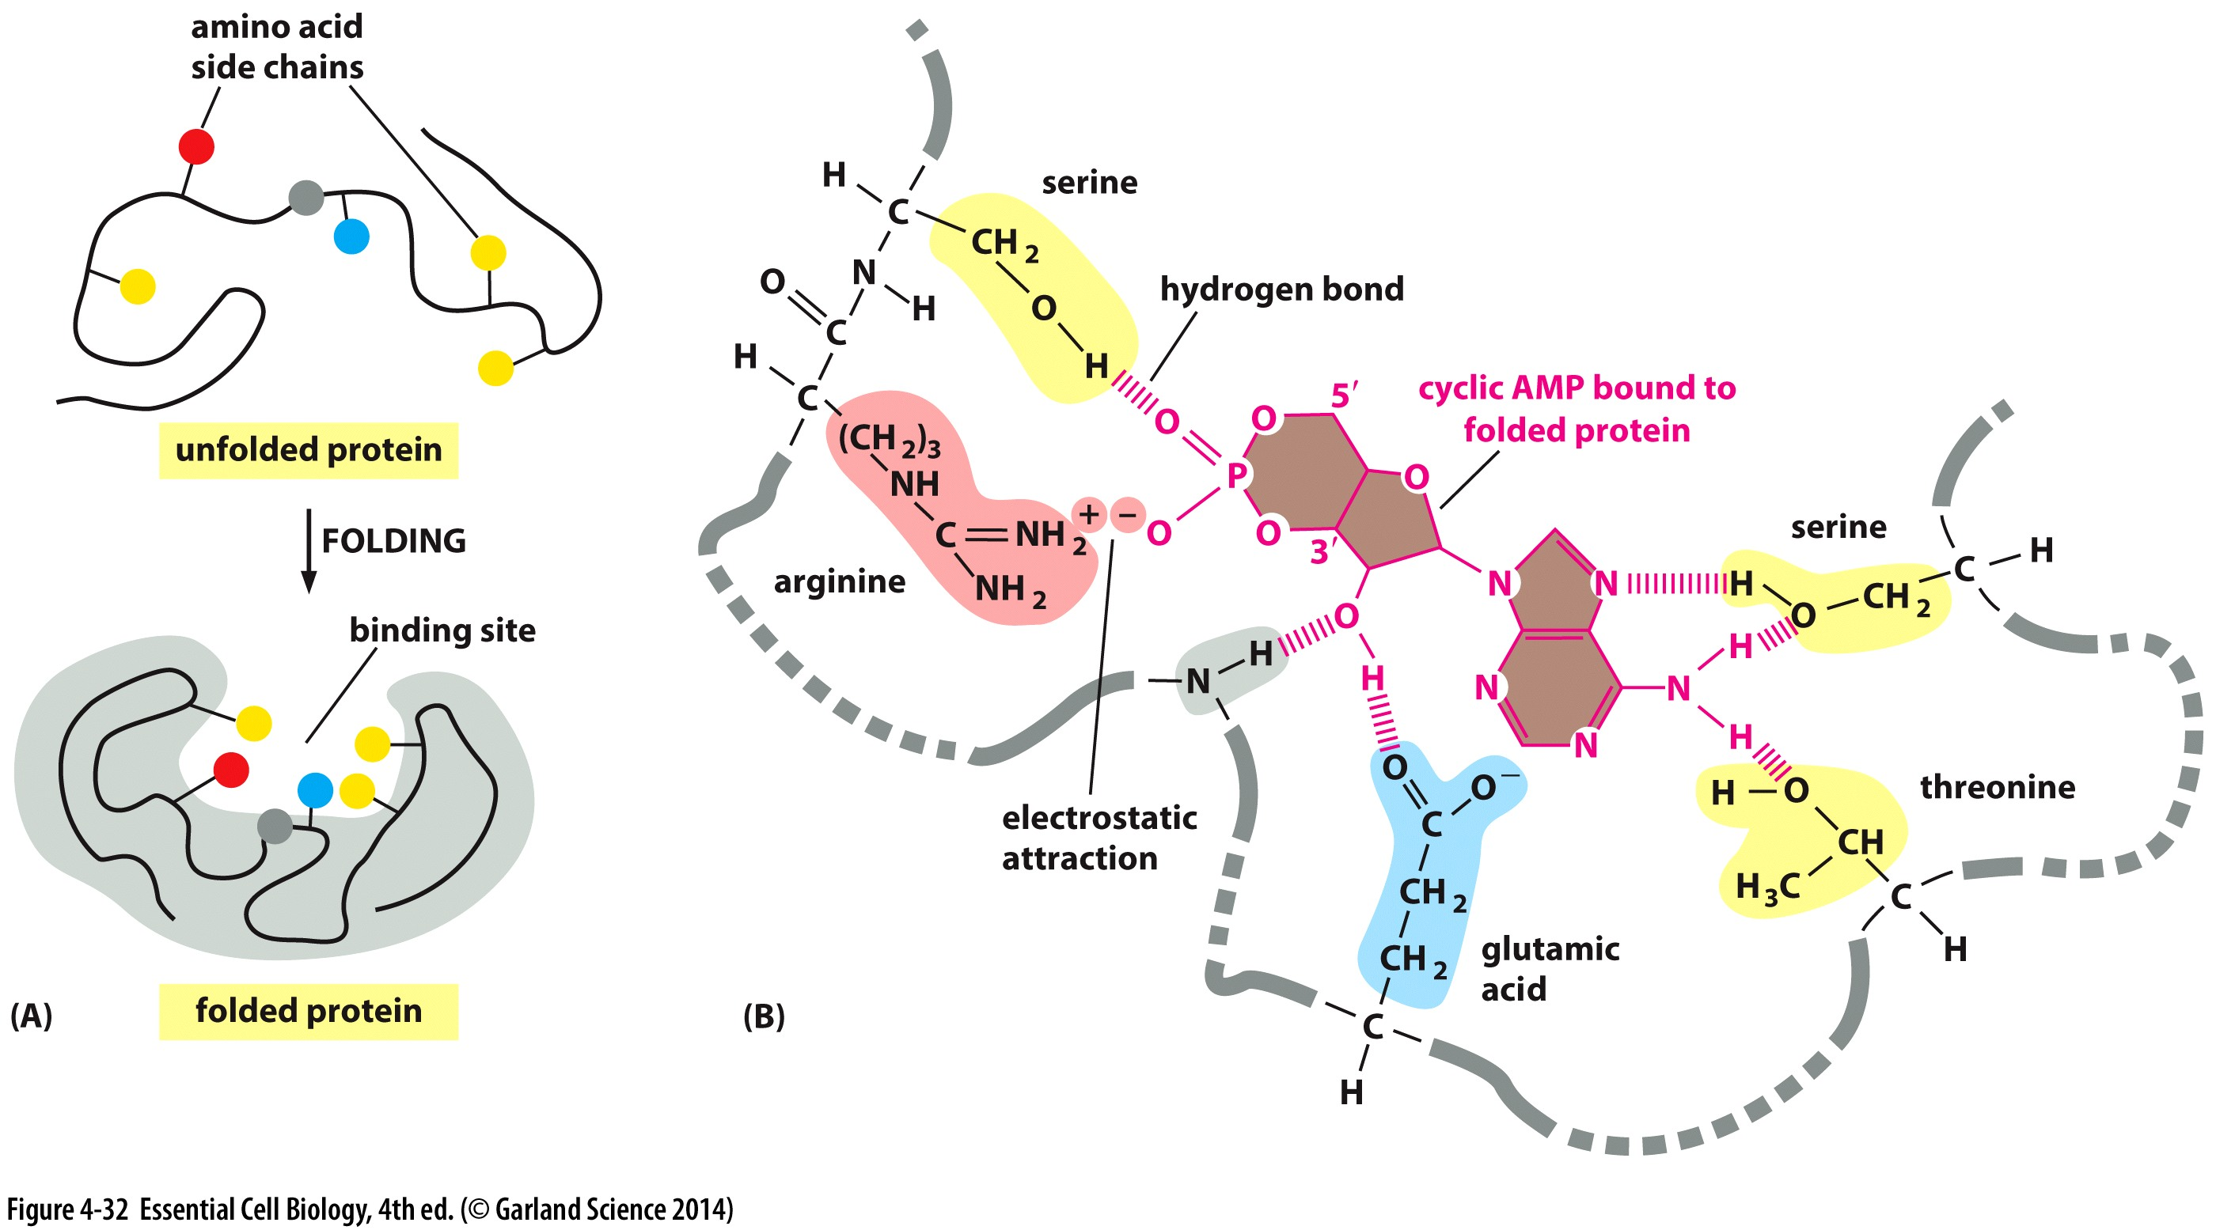
Binding to other molecules
*Ability to bind is dictated by sequence and structure*
The function of many proteins is dependent on their ability to bind other proteins

Slide 21
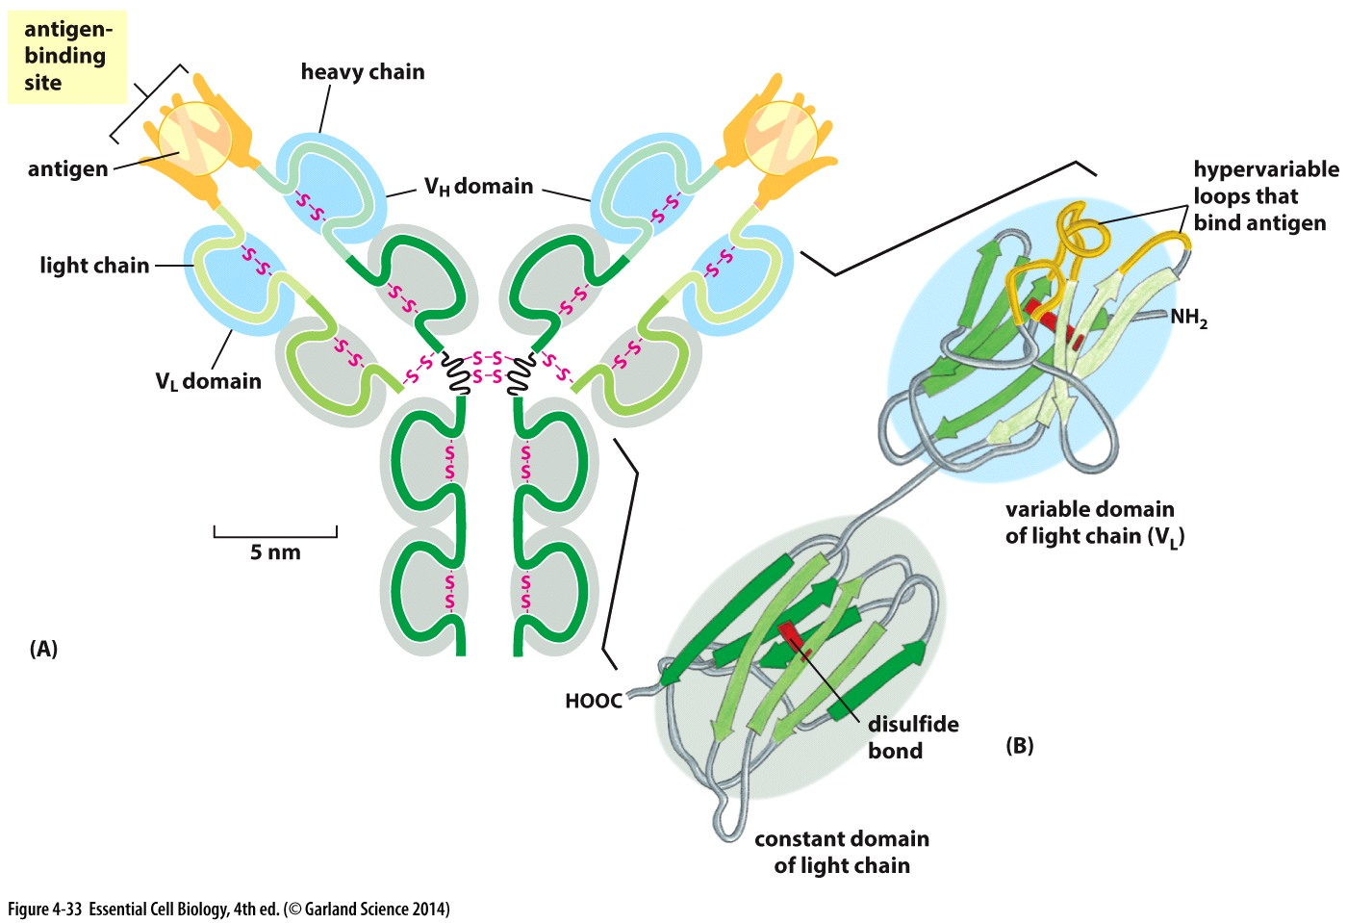
Binding for Function
Antibodies
Billions of different antibodies
Amino acid sequence in hypervariable loops dictates which antigens it binds
Each with different binding site
Overall structure is similar/near identical
Stacked β sheets
Reinforced with disulfide bonds

Slide 22
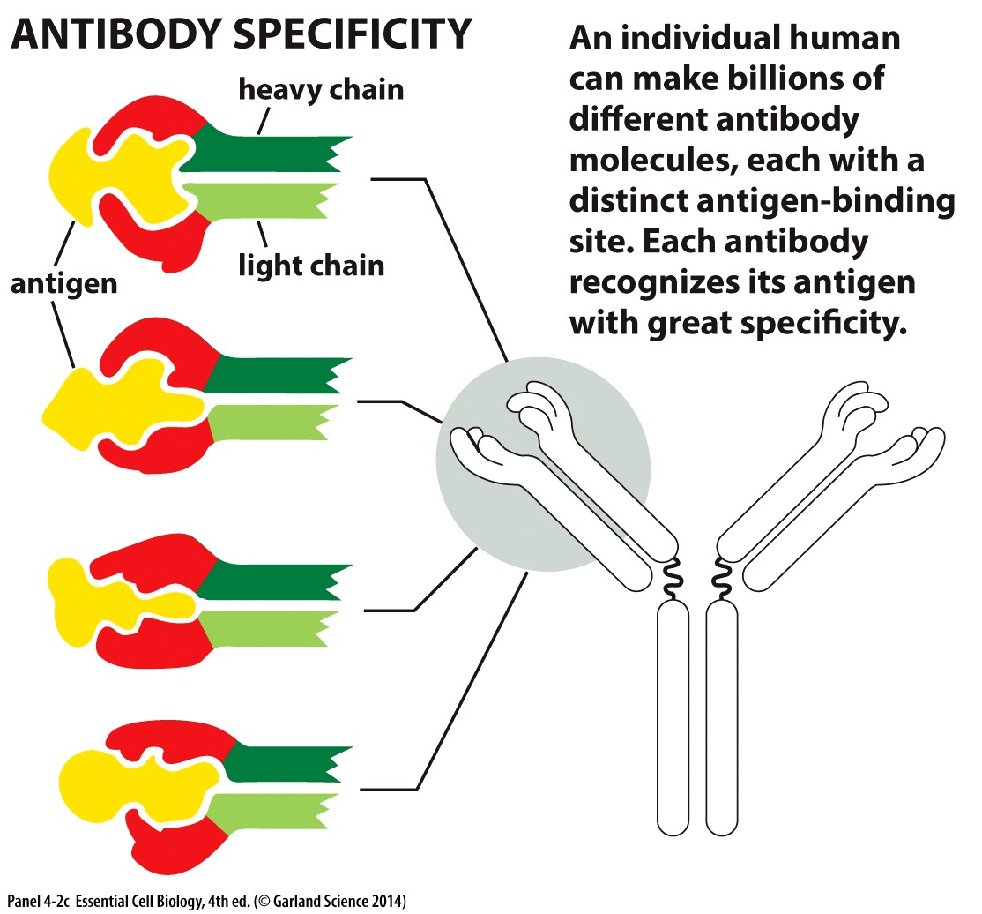
Binding for Function
Antibodies
Billions of different antibodies
Amino acid sequence in hypervariable loops dictates which antigens it binds
Each with different binding site
Overall structure is similar/near identical
Small differences in binding sites mean dramatic differences in binding partners

Slide 23
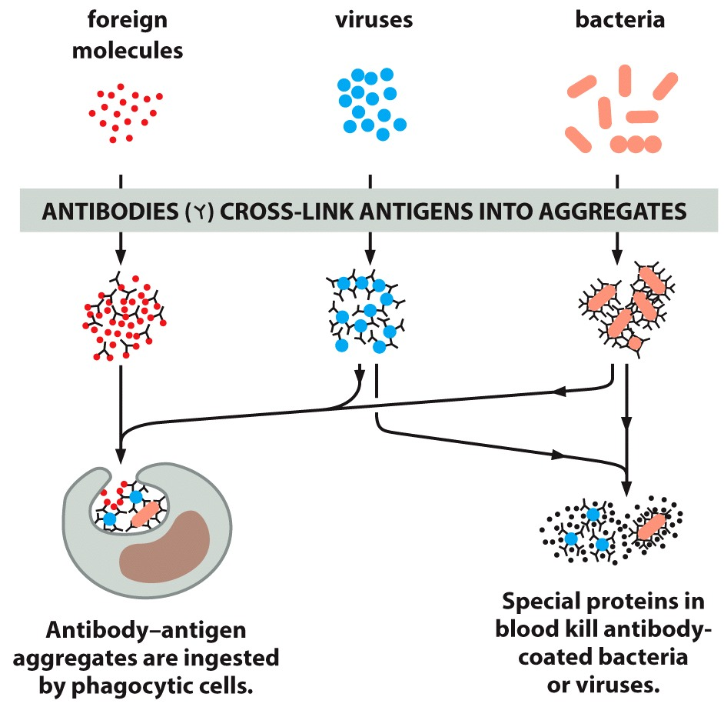
Variability that allows for great specificity is essential to antibody function: recognizing threats

Slide 24
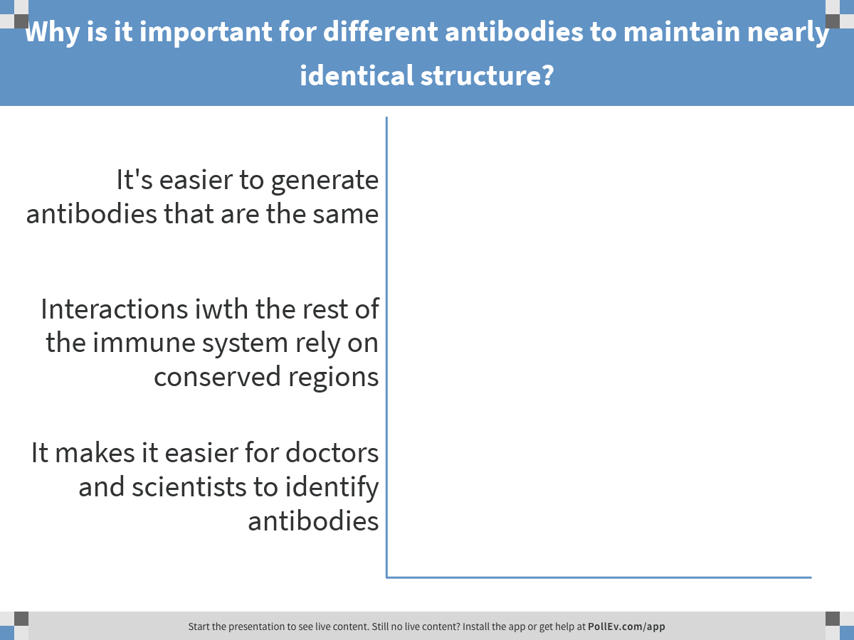
Differences in hypervariable regions permit recognition of billions of antigens. Based on your reading…
Notes:
Why is it important for different antibodies to maintain nearly identical structure?
https://www.polleverywhere.com/multiple_choice_polls/tg6kiSoMydXN05P

Slide 25
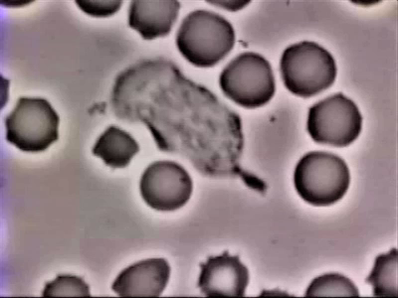
Variability that allows for great specificity is essential to antibody function: recognizing threats
Conserved regions are also essential for function: activating immune response

Slide 26
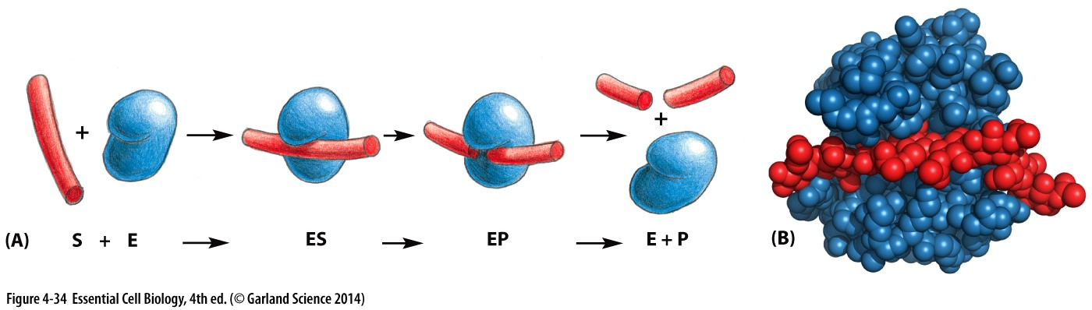
Binding for Function
Enzymes: chemically modify other proteins
Bind substrate
Catalyze reaction to make or break covalent bonds
Release product
Repeat steps 1-3
Amino acid sequence denotes specificity of an enzyme
Substrates must be a specific size/charge/conformation to access the active site

Slide 27
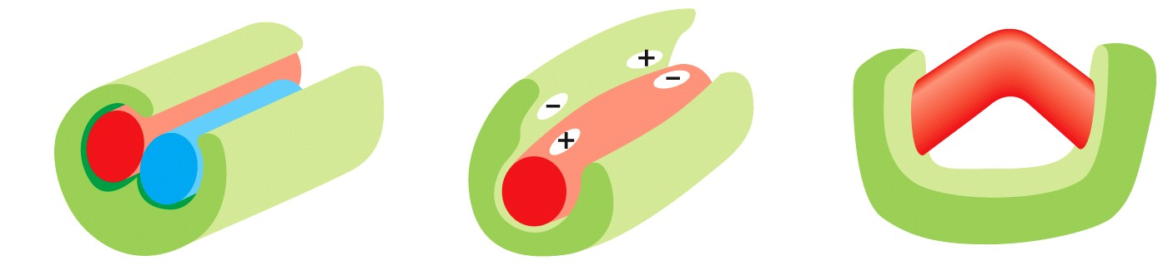
Binding for Function
Enzymes: chemically modify other proteins
Bind substrate
Catalyze reaction to make or break covalent bonds
Release product
Repeat steps 1-3
Amino acid sequence denotes specificity of an enzyme
Substrates must be a specific size/charge/conformation to access the active site
Substrate binding to the enzyme promotes the reaction
Proximity or two substrates
Stabilize charged intermediates
Conformation change
1 2 3

Slide 28
Control of protein function
Direct binding
Covalent modifications

Slide 29
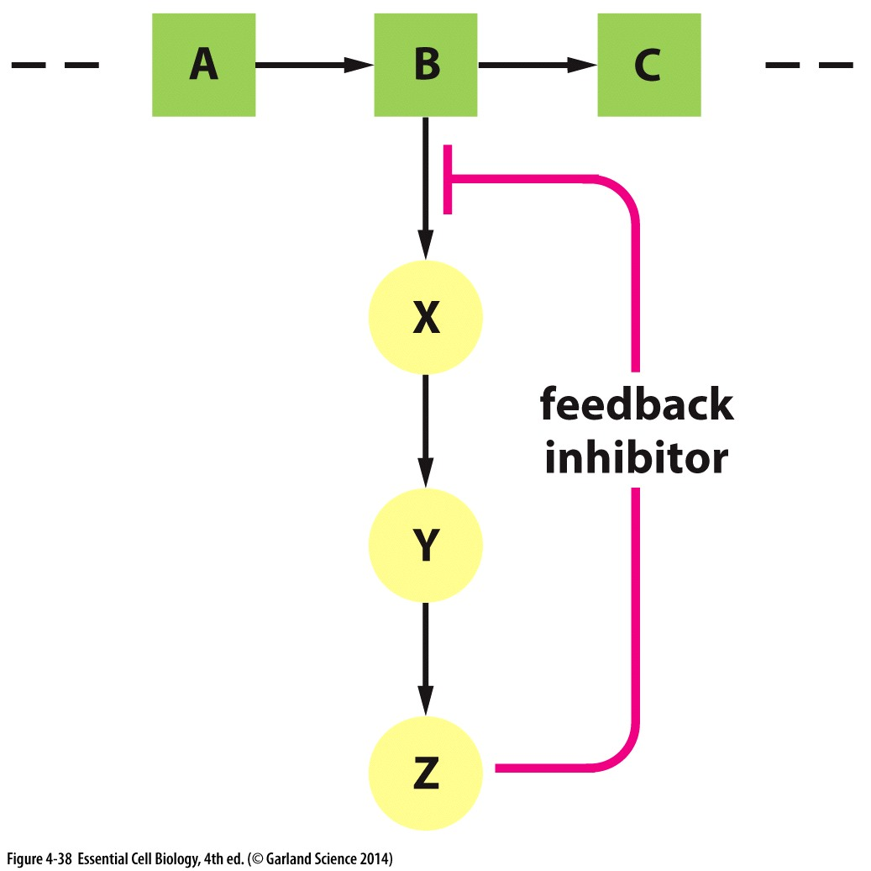
Direct biding to regulate enzyme activity
Feedback loops
Downstream product binds upstream protein
limits activity (or promotes activity)
Notes:
Catalytic activity of enzymes is often regulated by other molecules

Slide 30
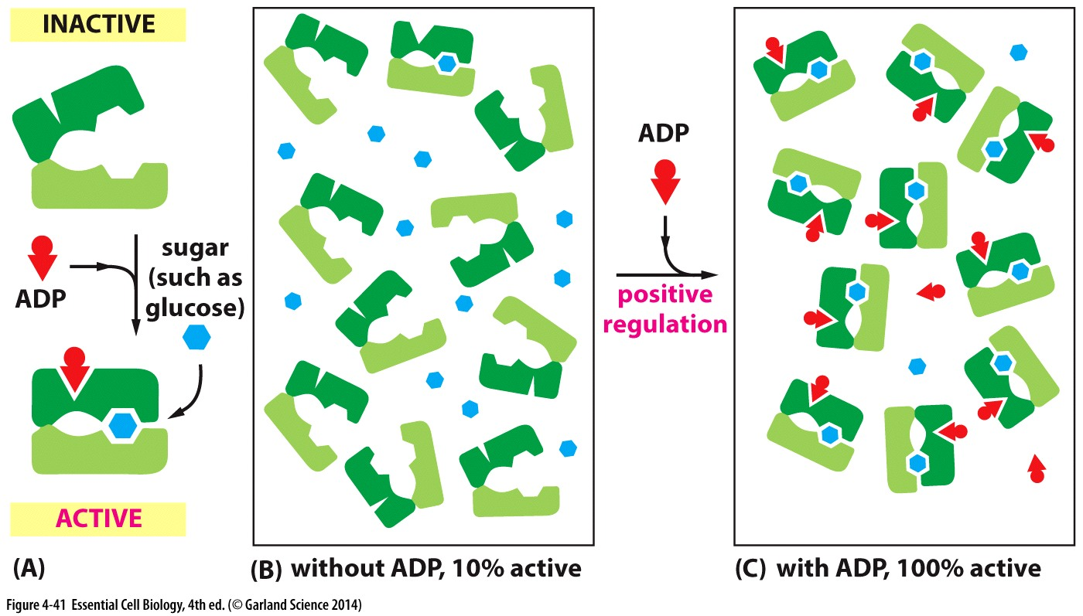
Direct biding to regulate enzyme activity
Allosteric interactions= multiple binding sites that influence one another
cooperative binding
Notes:
Catalytic activity of enzymes is often regulated by other molecules

Slide 31
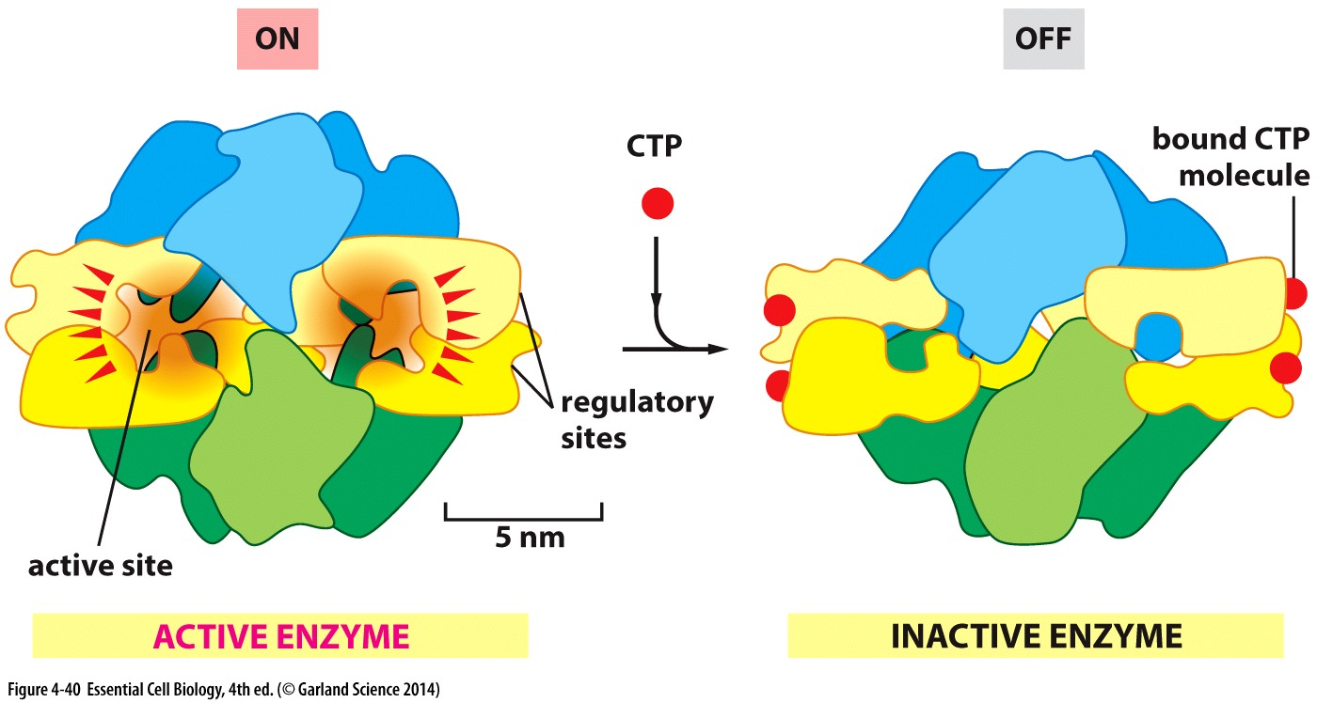
Direct biding to regulate enzyme activity
Allosteric interactions= multiple binding sites that influence one another
cooperative binding
Inhibitory Binding
Notes:
Catalytic activity of enzymes is often regulated by other molecules

Slide 32
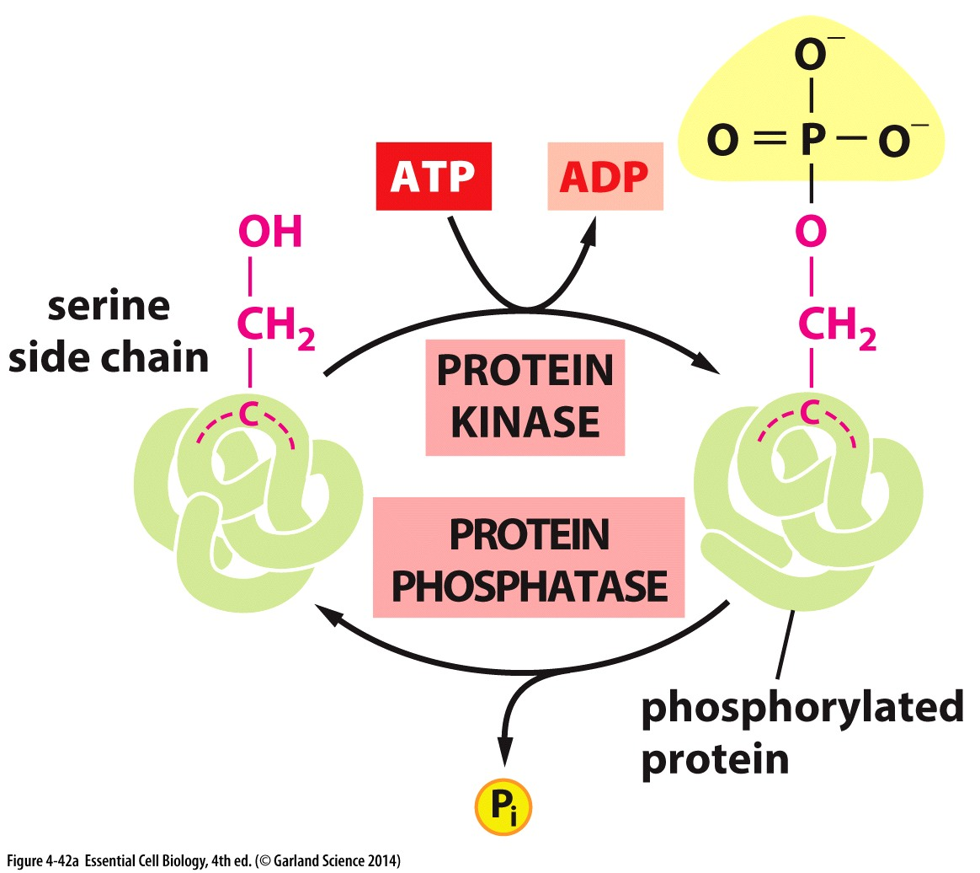
Covalent modifications to regulate activity
Inhibitory binding (pathway feedback) and enzyme regulation (cooperative and inhibitory) rely on non-covalent interactions
Post-translational modifications: covalently linked
Placed on proteins after they are made and folded
Influence structure and/or function
Common modifications:
Phosphorylation (adding a phosphate group)
Ubiquitylation (adding a ubiquitin protein)
Sumoylation (addition of Small Ubiquitin-like Modifier: SUMO)
Notes:
Catalytic activity of enzymes is often regulated by other molecules

Slide 33
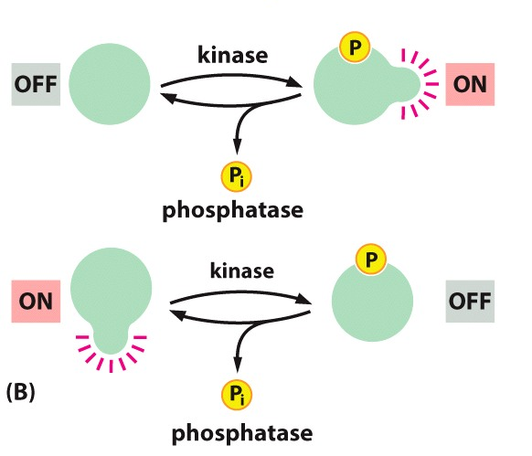
Covalent modifications to regulate activity
Sometimes adding a phosphate turns ON a protein’s activity
Sometimes adding a phosphate turns OFF a protein’s activity
Charged group:
Impact protein folding
Binding partners
Notes:
Catalytic activity of enzymes is often regulated by other molecules

Slide 34
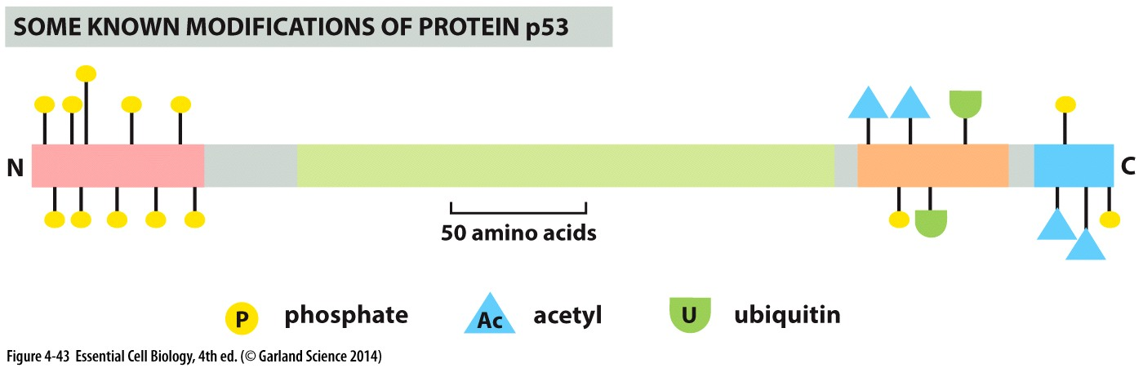
Complex regulation of complex activities
Many proteins exhibit multiple modifications: enable complex, multi-tiered regulation
Regulate binding partners
Regulate localization
Example: p53
P53 is a tumor suppressor that senses cellular damage and makes decisions whether to repair the damage, stop the cell from growing and dividing, or activate cell death (apoptosis)
Complex decisions that require complex regulation!
Notes:
Catalytic activity of enzymes is often regulated by other molecules

Slide 35
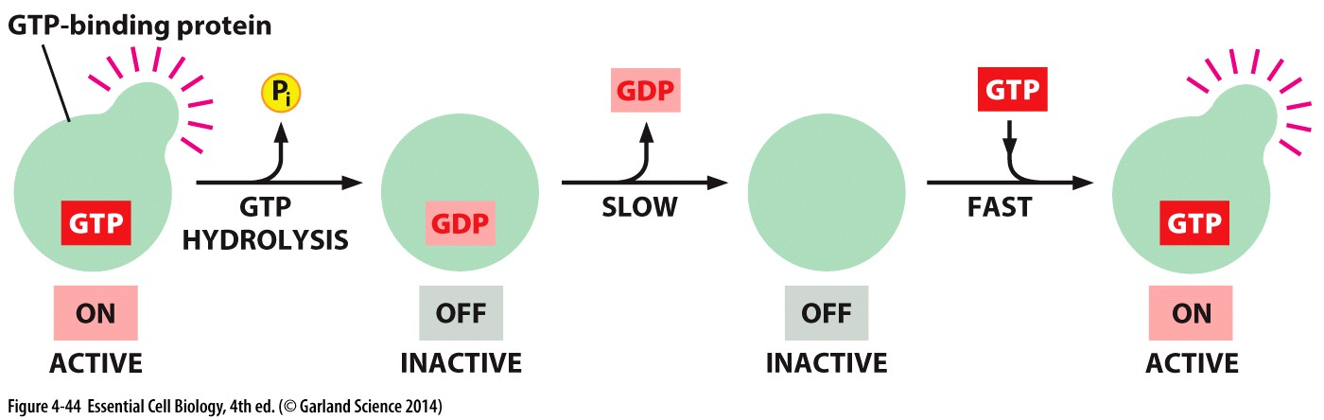
Other ways to regulate using phosphates
Phosphate NOT enzymatically transferred to a protein
Phosphate remains part of Guanosine triphosphate (GTP) or adenosine triphosphate (ATP)
GTP binds the protein directly and enforces an ‘active state’
Hydrolysis of the bound GTP: GTP→ GDP + Pi causes a conformational change and switch to ‘inactive state’
GTP is released and can be replaced by new GTP to repeat the cycle
Notes:
Catalytic activity of enzymes is often regulated by other molecules

Slide 36
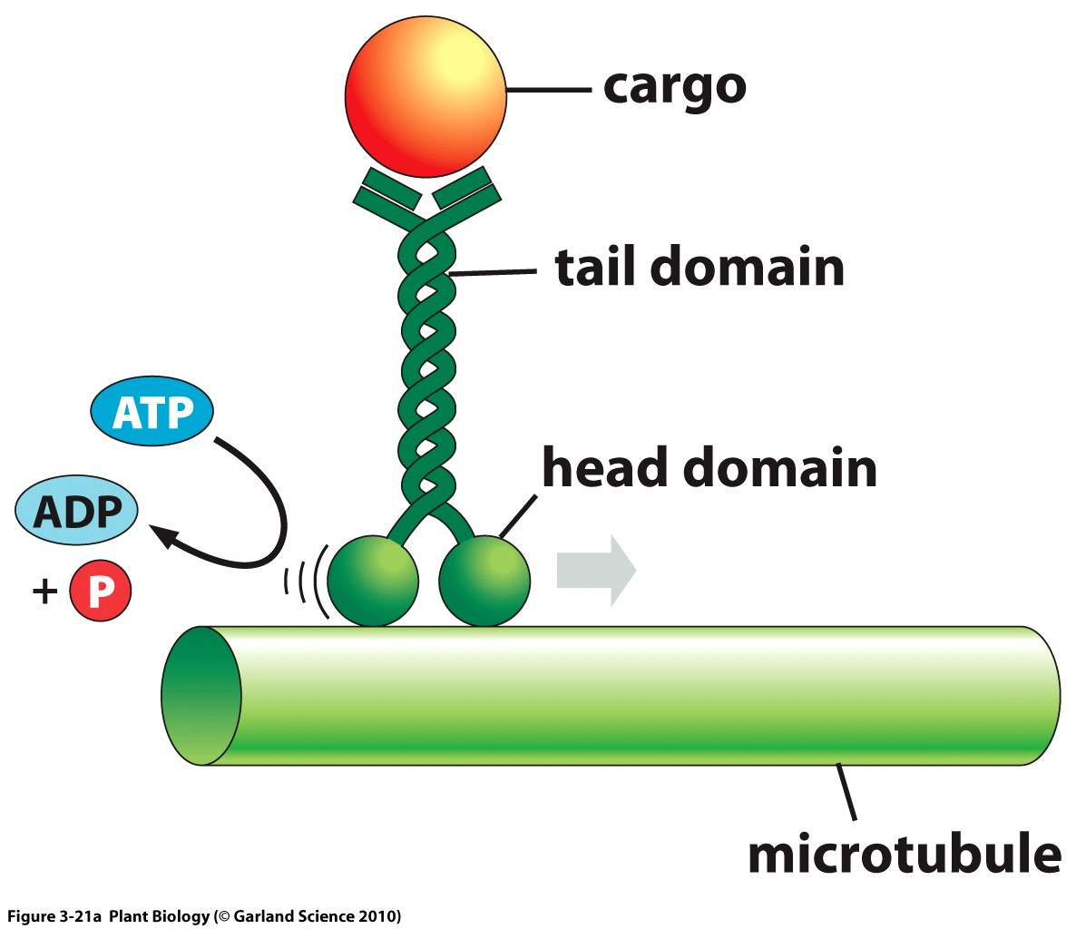
Other ways to regulate using phosphates
GTP and ATP hydrolysis
binding-hydrolysis-release cycle regulates activity
Often GTP/ATP-bound form is active
‘activity’ can be on/off that impact biding partners or larger conformational changes
Example: kinesin motor on microtubule tracks
Kinesin binds ATP
Hydrolysis causes conformation changes in the kinesin motor
Conformational changes can lead to ‘walking’ movement
Notes:
Catalytic activity of enzymes is often regulated by other molecules

Slide 37
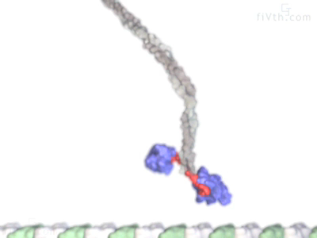
ATP Hydrolysis to generate movement
Kinesins are multi-subunit proteins that use ATP hydrolysis to promote conformational changes and ‘walk’ along microtubule filaments
Function as motors to carry intracellular cargo along microtubule tracks
Notes:
Catalytic activity of enzymes is often regulated by other molecules

